Slide 1
Deep Learning (CS324)
7. Autoencoders*
Prof. Jianguo Zhang
SUSTech
*Based on http://www.deeplearningbook.org chapters 5.11.3, 13.5 & 14 + sources mentioned in slides
Notes:
In this topic, we will talk about another important family of deep neural networks: autoencoders. It is very successful in manifold learning, dimensionality reduction, denoising, image generation etc. It is part of the fully convolutional neural networks. It extensions could be used to perform image segmentation, for example, Fully convolutional net (FCN) and U-NET.

Slide 2
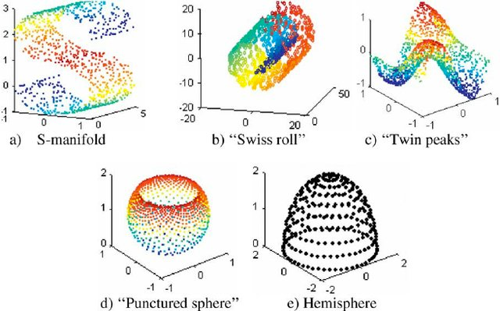
Manifold hypothesis
Real-world data lives in a low-dimensional non-linear manifold
Karbauskaitė et al. "Topology preservation measures in the visualization of manifold-type multidimensional data”, 2009
Notes:
Let us look at how it could be used to learn manifold. First, what is a manifold? An important concept underlying many ideas in machine learning is that of a manifold. A manifold is a connected region. Mathematically, it is a set of points, associated with a neighborhood around each point. From any given point, the manifold locally appears to be a Euclidean space. In everyday life, we experience the surface of the world as a 2-D plane, but it is in fact a spherical manifold in 3-D space.

Slide 3
Manifold hypothesis
In other words, the data is concentrated with high probability in a small non-linear region of space
Karbauskaitė et al. "Topology preservation measures in the visualization of manifold-type multidimensional data”, 2009

Slide 4
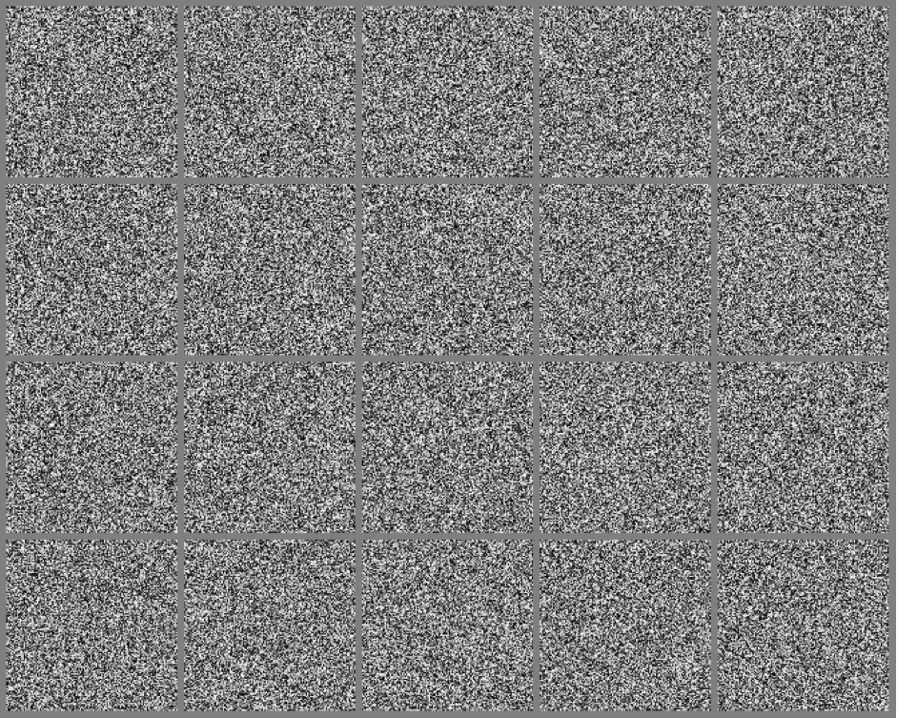
Uniformly sampled images from the space of 256x256 pixels

Slide 5
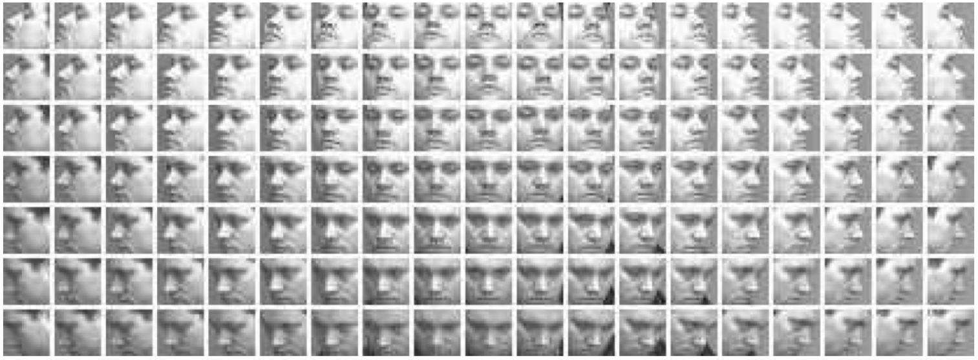
Real-world data example: images of faces
QMUL faces dataset: 133 facial images covering a view of +/-90 degrees in yaw and +/-30 degrees in tilt at 10 degrees increment

Slide 6
Real-world data example: images of faces
Human face has about 50 muscles, 3 cartesian coordinates (translations) and 3 Euler angles (rotations), so the manifold of faces of a person has less than 56 dimensions

Slide 7
Real-world data example: images of faces
PROBLEM: how to find these dimensions/coordinates automatically?

Slide 8
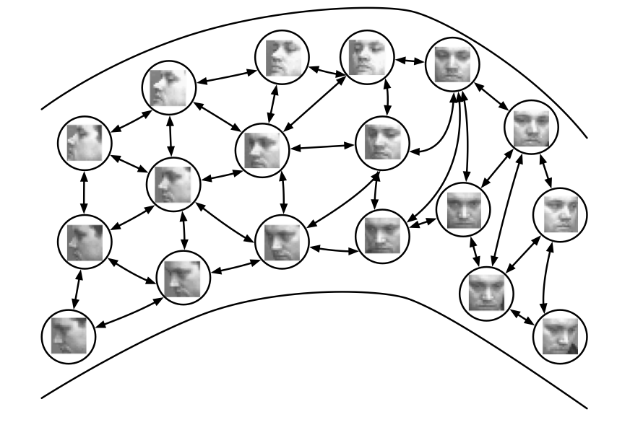
Real-world data example: images of faces
PROBLEM: how to find these dimensions/coordinates automatically?

Slide 9
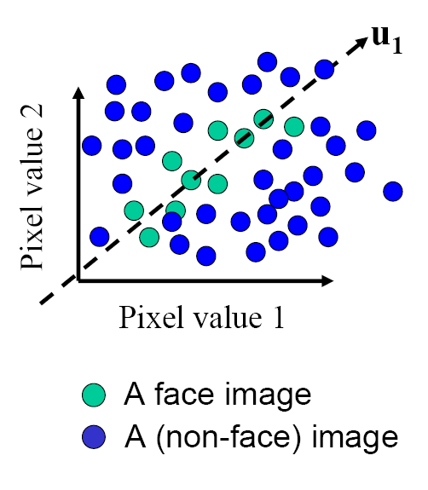
Principal Component Analysis
The goal is to find the directions that best explain the variations of the data
To find several directions (a subspace) such that the variance of the projected data in the subspace is maximized.

Slide 10
Principal Component Analysis
Given: N data points x₁, … ,x_{N} in R^{d}
Choose an unit vector u in R^{d} that captures the most data variance
Therefore, we could construct a new set of features by projecting the data onto those directions: u(x_{i}) = u^{T}(x_{i} – µ) (µ: mean of data points)

Slide 12
Principal Component Analysis
Direction that maximizes the variance of the projected data:
N
Maximize
subject to ||u||=1
Projection of data point
N
1/N
Covariance matrix of data
The direction that maximizes the variance is the eigenvector associated with the largest eigenvalue of Σ

Slide 14
Implementation Issue
Covariance matrix is huge (d² for d dimensions)
But typically # examples << d
Simple trick
X is matrix of centralised training data (each row is an observation)
Solve for eigenvectors u of XX^{T} instead of X^{T}X
Then X^{T}u is eigenvector of covariance X^{T}X
May need to normalize (to get unit length vector)

Slide 15
Principal Component Analysis
2nd Principal
Component, y₂
1st Principal
Component, y₁
The meaning of directions -- Eigen vectors

Slide 16
PCA Scores
x_{i2}
y_{i,2}
y_{i,1}
x_{i1}
The geometrical meaning of projection on those directions

Slide 17
PCA Eigenvalues
λ₂
λ₁

Slide 18
PCA - Summary
PCA defines an orthogonal linear transformation from an input x to a representation z = f(x)
More formally, if X is the where each row corresponds to a data sample, T = XW denotes the full principal components decomposition, where W is the matrix whose columns are the eigenvectors of X^{T}X
To reduce the dimensionality of the input we use only the first k eigenvectors, which yields Tk = XWk

Slide 19
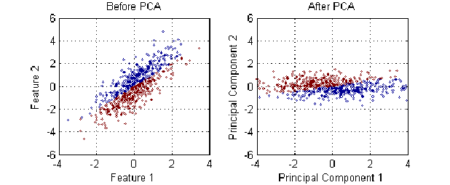
Principal components analysis
PCA defines an orthogonal linear transformation from an input x to a representation z = f(x)
Source: Li et al., A Robust Deep Model for Improved Classification of AD/MCI Patients, 2015

Slide 20
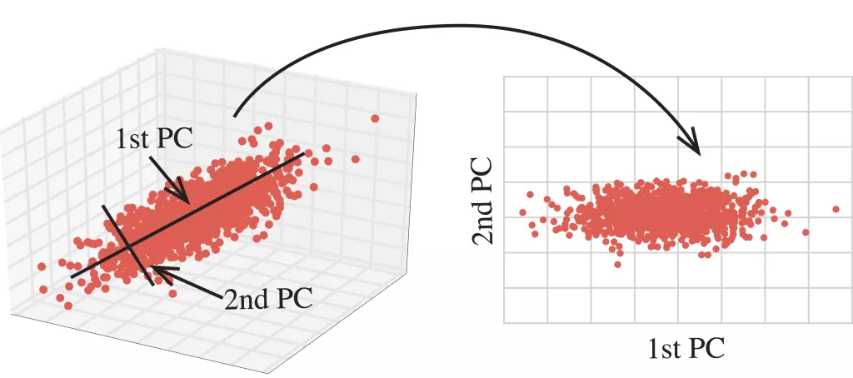
Principal components analysis
PCA defines an orthogonal linear transformation from an input x to a representation z = f(x)
Source: http://blog.kaggle.com/2017/04/10/exploring-the-structure-of-high-dimensional-data-with-hypertools-in-kaggle-kernels/

Slide 21
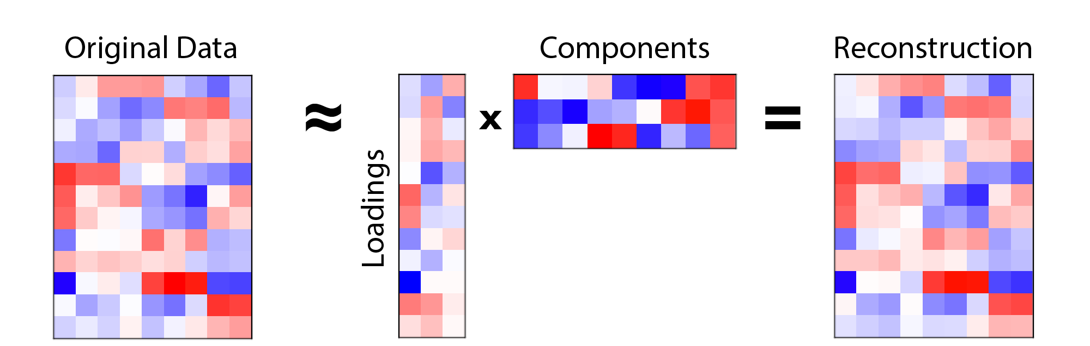
Input reconstruction with PCA
Tk
X
Wk^{T}
Y
Y = Tk Wk^{T}
Source: http://alexhwilliams.info/itsneuronalblog/2016/03/27/pca/

Slide 22
Input reconstruction with PCA
Tk
X
Wk^{T}
Y
PCA minimises the l2 distance between X and Y
Source: http://alexhwilliams.info/itsneuronalblog/2016/03/27/pca/

Slide 23
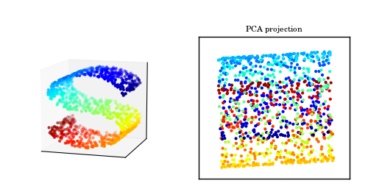
PCA limitations
However our ability to capture the structure of the data in the original space is limited by the type of transformations we consider (orthogonal linear)
Source: http://www.astroml.org/book_figures/chapter7/fig_S_manifold_PCA.html

Slide 24
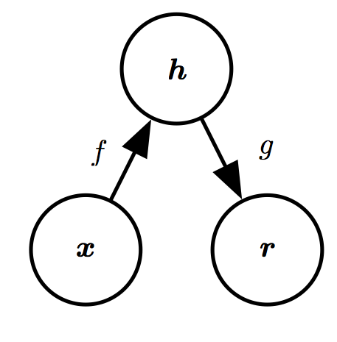
Autoencoders
An autoencoder is neural networks that is trained to copy its input to its output
It can generalise PCA by accounting for non-linear transformations

Slide 25
Autoencoders
An autoencoder is neural networks that is trained to copy its input to its output
It can generalise PCA by accounting for non-linear transformations
Hidden layer (code)
Encoder function
Decoder function
Input
Reconstruction

Slide 26
Autoencoders
An autoencoder is neural networks that is trained to copy its input to its output
It can generalise PCA by accounting for non-linear transformations
Hidden layer (code)
(Neural network)
(Neural network)
Encoder function
Decoder function
Input
Reconstruction

Slide 27
Autoencoders
We want to force the code to have a lower dimensionality than the input
We want to learn a low-dimensional representation which captures the salient features of the input
Hidden layer (code)
Encoder function
Decoder function
Input
Reconstruction

Slide 28
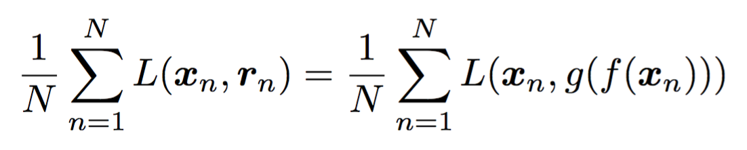
Autoencoders
Minimise the loss/reconstruction error
Hidden layer (code)
Encoder function
Decoder function
Input
Reconstruction

Slide 29
Autoencoders
Backprop and SGD to find the optimal parameters
Hidden layer (code)
Encoder function
Decoder function
Input
Reconstruction

Slide 30
Autoencoders
With l2 norm and f, g linear we recover PCA
Hidden layer (code)
Encoder function
Decoder function
Input
Reconstruction

Slide 31
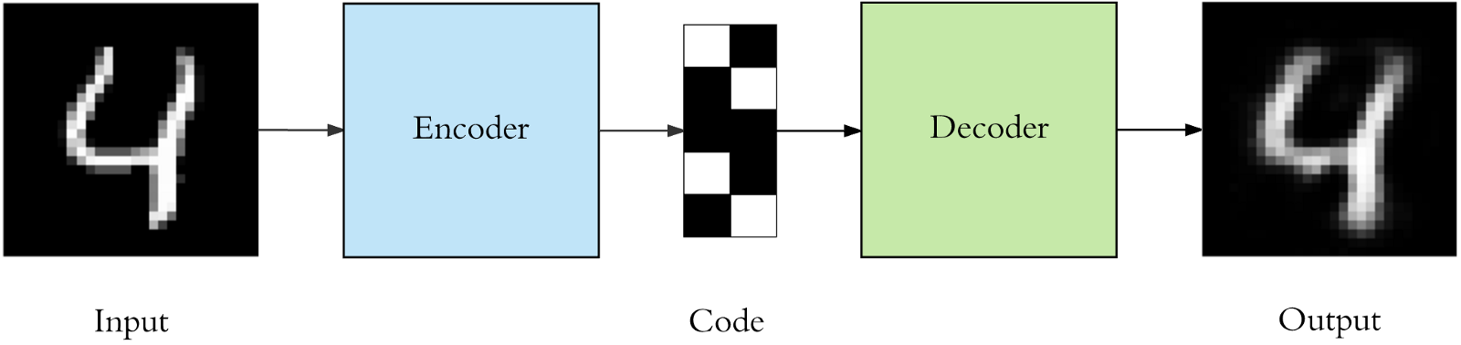
Autoencoders
Example: one-layer encoder + one-layer decoder
Source: https://towardsdatascience.com/applied-deep-learning-part-3-autoencoders-1c083af4d798

Slide 32
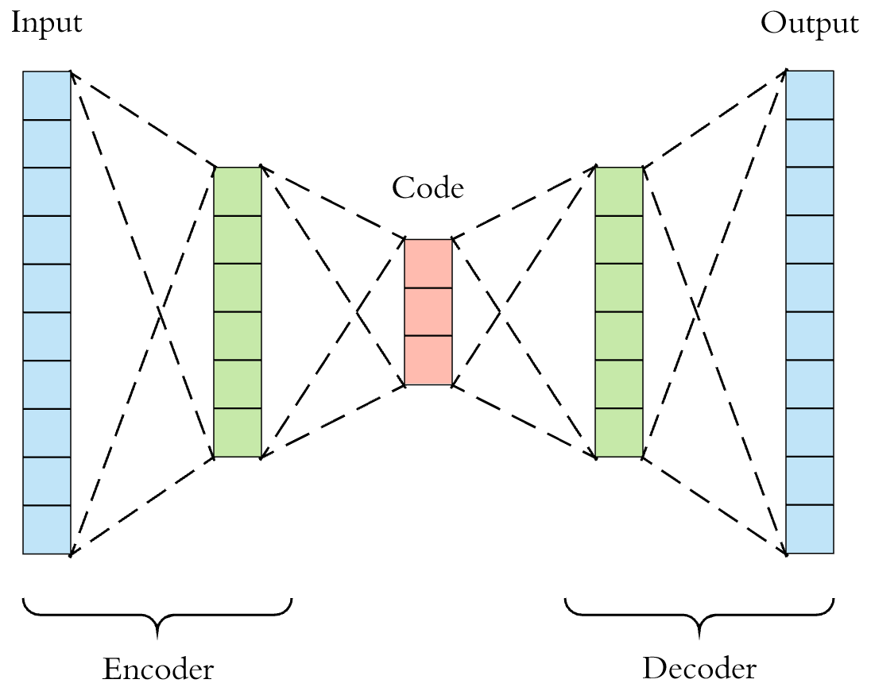
Deep autoencoders
Source: https://towardsdatascience.com/applied-deep-learning-part-3-autoencoders-1c083af4d798

Slide 33
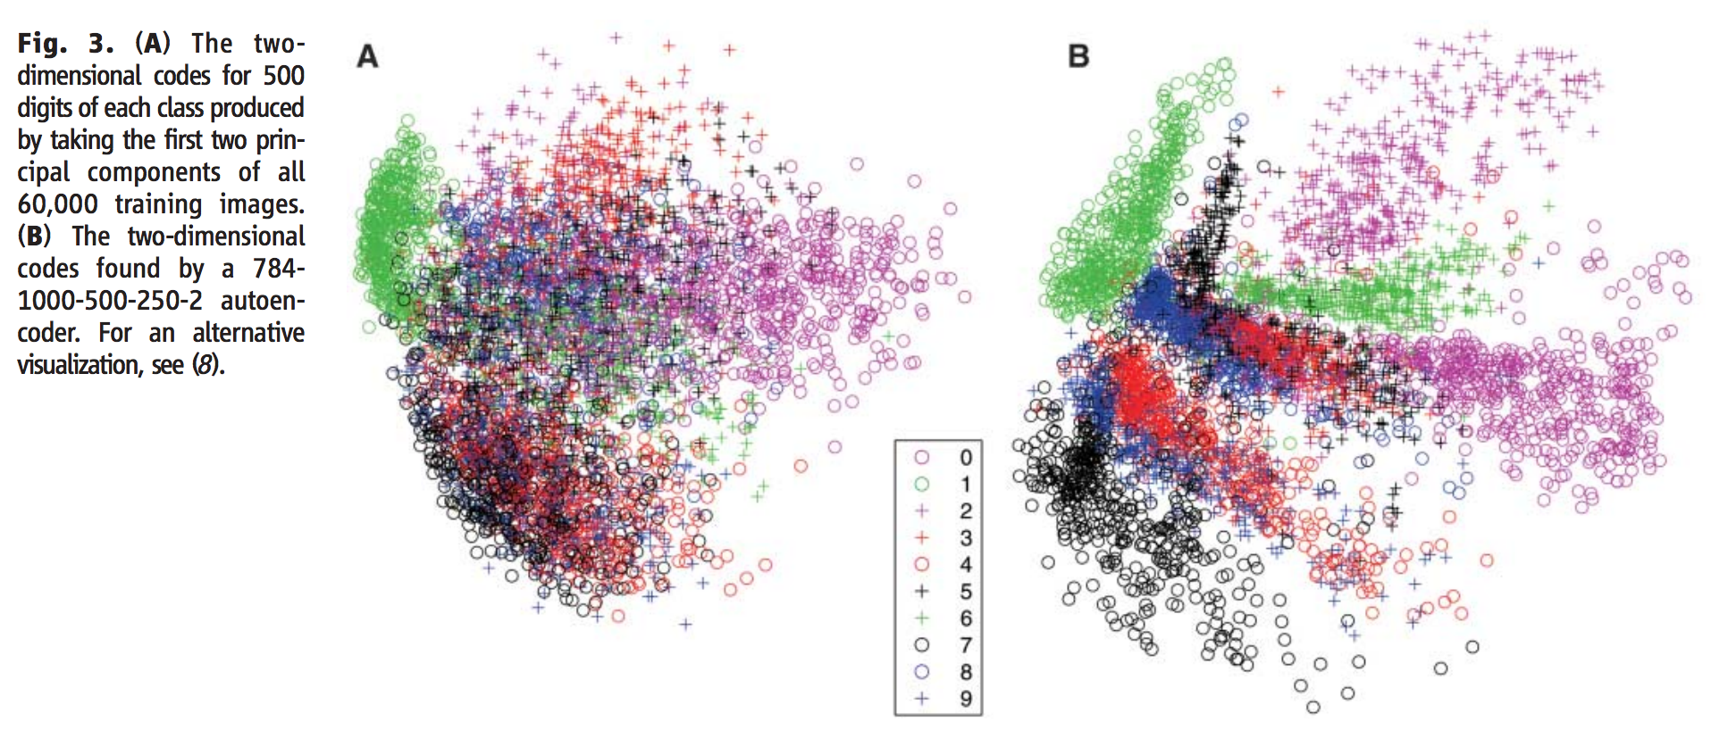
PCA vs autoencoders
Source: https://www.cs.toronto.edu/~hinton/science.pdf

Slide 34
Undercomplete autoencoders
Undercomplete autoencoders (what we talked about in the previous slides)
code has lower dimension than input
f or g has low capacity (e.g., linear g)
If the encoder and decoder have high capacity we can learn trivial transformations
A one-dimensional code with a very powerful non-linear encoder could learn to represent each training example xi with the code i

Slide 35
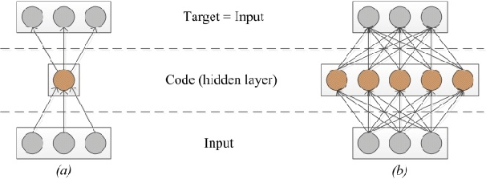
Overcomplete autoencoders
Overcomplete autoencoders
h has higher dimension than x
Gavat et al., Deep Learning in Acoustic Modeling for Automatic Speech Recognition and Understanding - An Overview, 2015

Slide 36
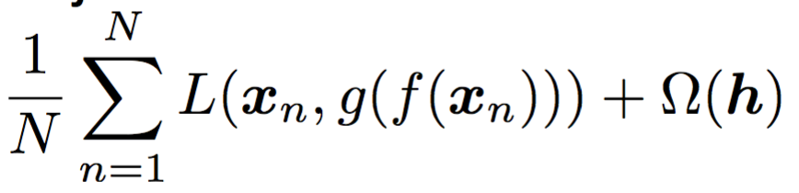
Overcomplete autoencoders
Overcomplete autoencoders
h has higher dimension than x
Must be regularised
Goal: Encourage the model to have other useful properties besides the ability to copy its input to its output

Slide 37
Regularised autoencoders
Sparse autoencoders
Denoising autoencoders
Contractive autoencoders

Slide 38
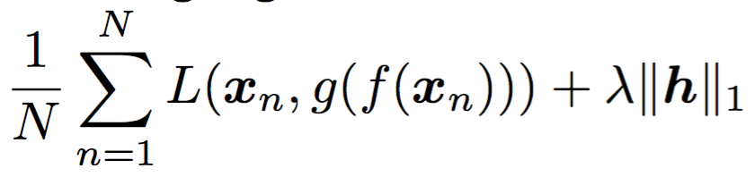
Sparse autoencoders
Limit capacity of autoencoder by adding a cost term that penalises the code for being larger, e.g.,
Typically used to extract robust features or lower the dimensionality of the input data
Notes:
Sparse autoencoders are typically used to learn features for another task such as classification. An autoencoder that has been regularized to be sparse must respond to unqiue statistical features of the dataset it has been trained on rather than simply acting as an identity function. In this way, training to perform the copying task with a sparsity penalty can yield a model that has learned useful features as a by product.

Slide 39
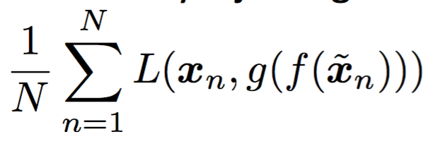
Denoising autoencoder
Instead of adding penalty, change reconstruction error to account for the introduction of noise
Noise could be Gaussian or Dropout, i.e., part of the input is randomly set to 0
The autoencoder learns a denoising map

Slide 40
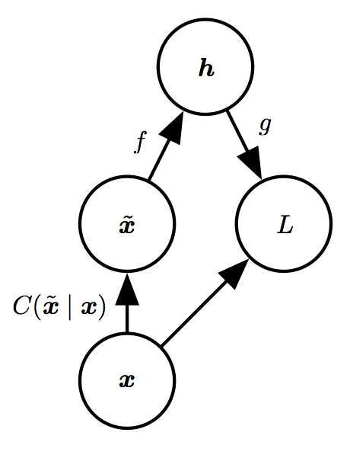
Denoising autoencoder
C is the corruption process which introduces noise

Slide 41
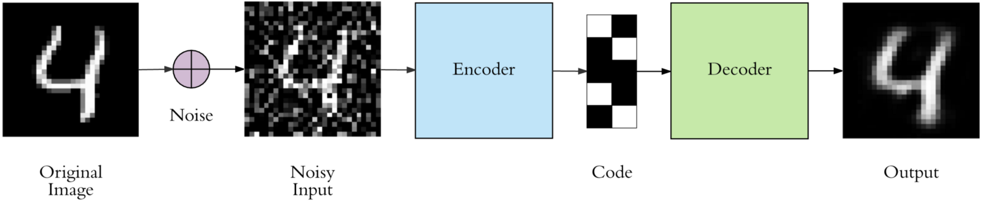
Denoising autoencoder
The network is forced to learn more robust representations

Slide 42
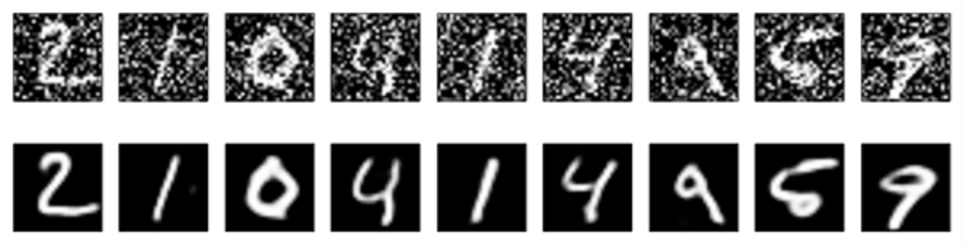
Denoising autoencoder
Application: image denoising

Slide 43
Denoising autoencoder
Application: image denoising

Slide 44
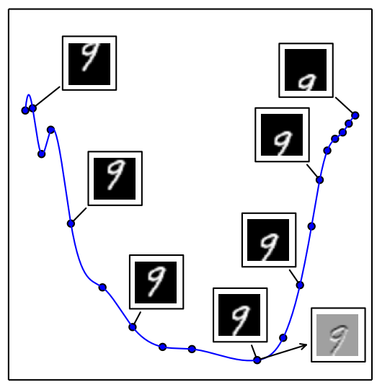
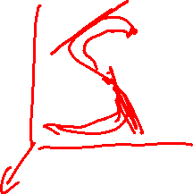
Autoencoders as manifold learners
At each point x of a d-dimensional manifold, a tangent plane is given by d basis vectors spanning the local directions of variation of the manifold
Grey pixel: no variation - Black/white: large variation

Slide 45
Autoencoders as manifold learners
Do autoencoders learn manifold structure?
Grey pixel: no variation - Black/white: large variation

Slide 46
Autoencoders as manifold learners
Training autoencoders combines two forces:
Reconstruction: learn h = f(x) such that x can be recovered from it through x = g(h)
Limited capacity: the encoder cannot represent any possible function f
These forces together push the hidden representation to capture information about the structure of the data-generating distribution

Slide 47
Autoencoders as manifold learners
Note: the autoencoder can only afford to model the variations needed to reconstruct the training data
If the training data concentrates near a manifold, only the variations tangent to the manifold around x need to correspond to changes in h = f(x)
Autoencoders learn representation that captures a local coordinate system of the manifold

Slide 48
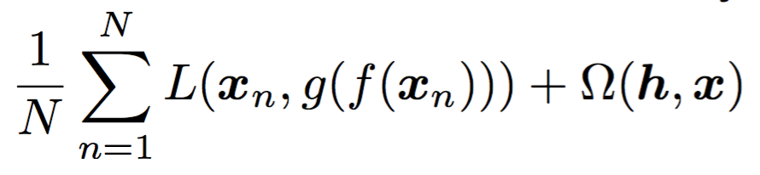
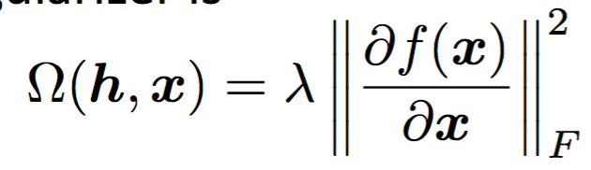
Contractive autoencoders
More explicit formulation to learn the manifold
Penalises the Frobenius norm of the Jacobian of the encoder, i.e., forces the encoder to learn a representation that doesn’t change much around training samples

Slide 49
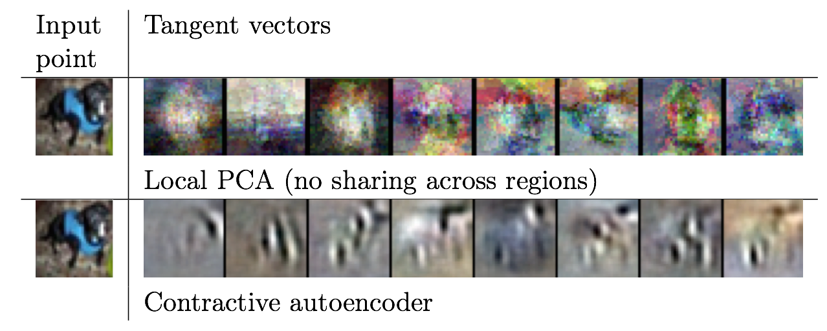
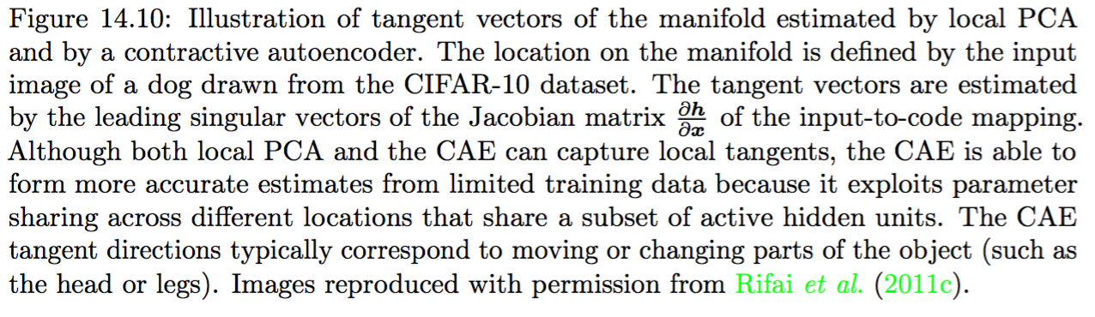
Contractive autoencoders

Slide 50
Applications of autoencoders
Dimensionality reduction
Image denoising
Features extraction
Watermarking removal
Image colouring
https://github.com/baldassarreFe/deep-koalarization

Slide 51
Summary
Autoencoders learn to encode and decode input via a latent space
Regularisation is needed to learn useful representations, and it can take many forms
The representations can be used as features or to lower the dimensionality of the input data
Denoising and contractive autoencoders are able to learn the manifold structure of the data
Demo: https://cs.stanford.edu/people/karpathy/convnetjs/demo/autoencoder.html

